Slide 1



Outlier Detection
Ben Fuqua
Notes:
Have you ever been traveling abroad, and you cannot use your credit card because it has been frozen? Or when you try to purchase an expensive item and your card gets declined? This is a form of outlier detection. Conrad Kennington, former head of machine learning at Kount a credit card fraud company, said: It is crucial for Data Scientists to understand outlier detection, and not just machine learning.
Outlier detection is the identification of rare items, events or observations which deviate significantly from the data

Slide 2
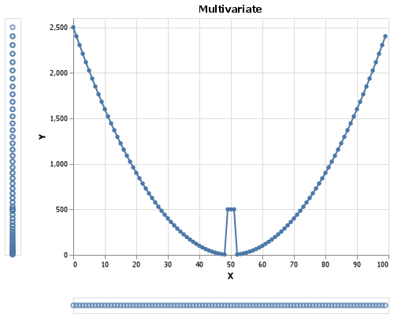
Why Multi-Variate?
Univariate: having one variable in the distribution
Multivariate: Having two or more variables in the distribution
Becomes difficult in high dimensional space
Benefit of Sklearn Python package
Notes:
2 Methods
Univariate: Looking only at 1 variable
Multivariate: Looking at 2 or more variables

Slide 3
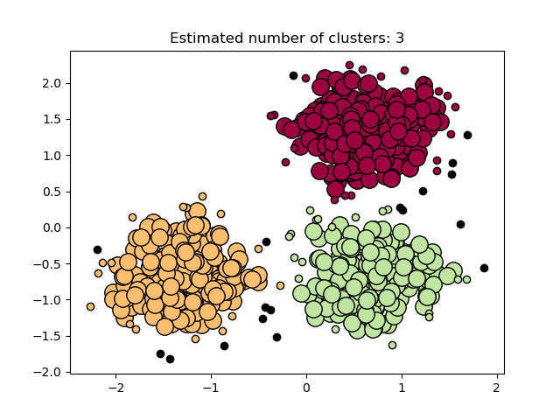
Density Based Spatial Clustering of Applications with Noise
Core Samples of high density
Creates clusters from Core Samples
2 main parameters:
Min_samples: n samples needed to create Core Samples
Eps: Distance
Metric: How distance is measured

Slide 4
DBSCAN
Core Samples of high density
Creates clusters from Core Samples
3 main parameters:
Min_samples: n samples needed to create Core Samples
Eps: Distance
Metric: How distance is measured

Slide 5
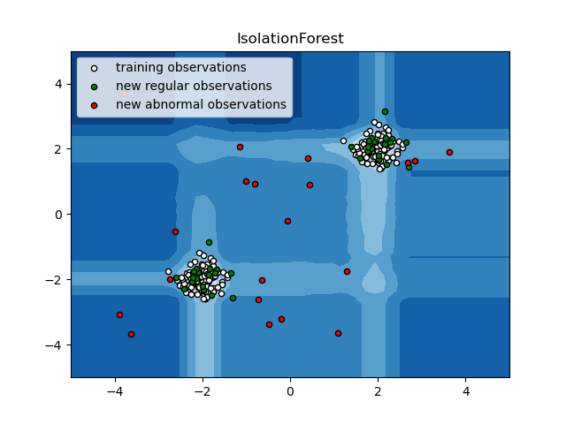
Isolation Forest
Creates partitions between min and max values
Can be represented in a ‘tree’ structure
1 main parameter:
Contamination: The ‘percent’ of contamination within the data
This will also remove x percent of rows

Slide 6
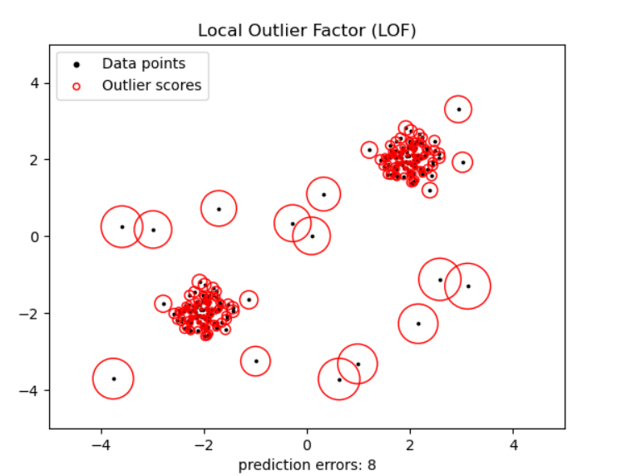
Local Outlier Factor
Focuses on Anomaly Score more than classification
Based on contamination parameter, will create a threshold
3 main parameters;
N_neighbors: number of points for a dense cluster
Metric: how distance is measured
Contamination: Percent contaminated

Slide 7
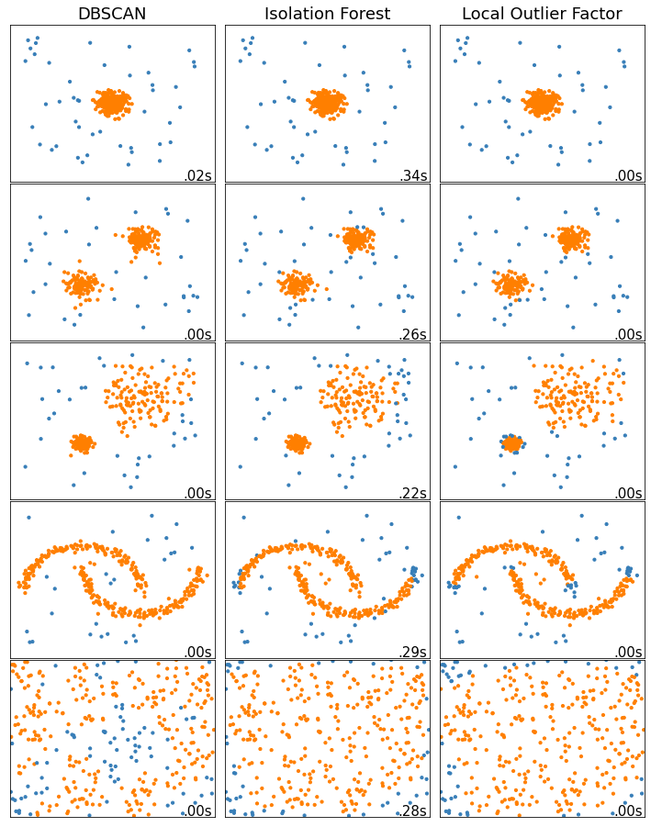

Slide 8
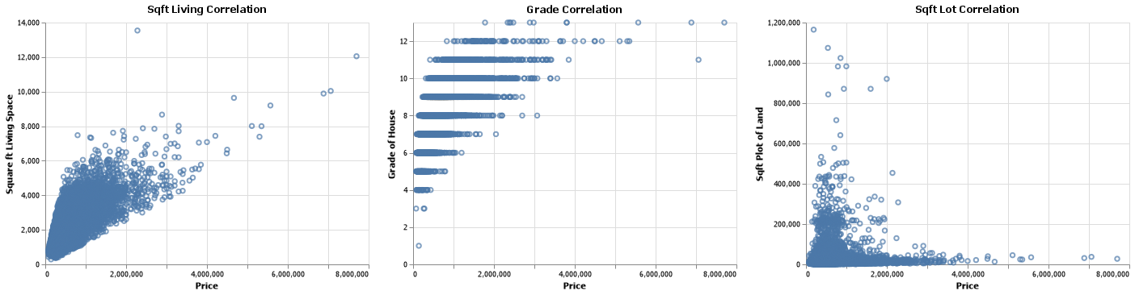
Base RMSE: $220,000
Application
Notes:
RMSE is a measurement of how well the model fits the data. The lower the number the better.
Which model keeps the highest amount of data for the lowest RMSE score
I tested each of the models with different parameters to find the ‘Best’ model that produced the lowest RMSE score while maintaining high percentage of data

Slide 9
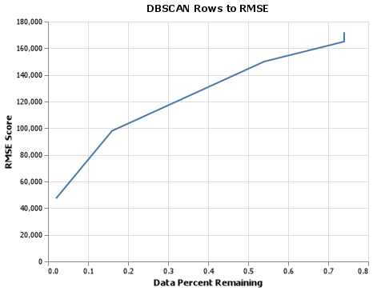
DBSCAN See Appendix for more info

Slide 10
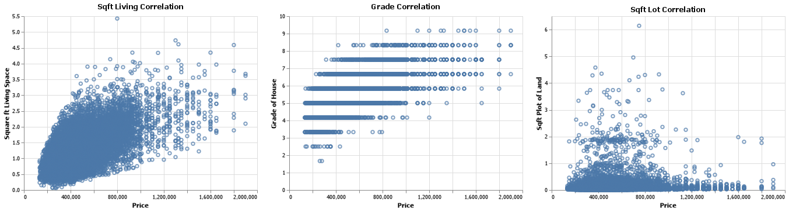
Resulting Data eps = 7 | min_samples = 8

Slide 11
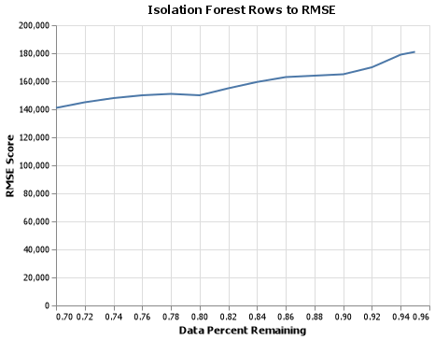
Isolation Forest

Slide 12
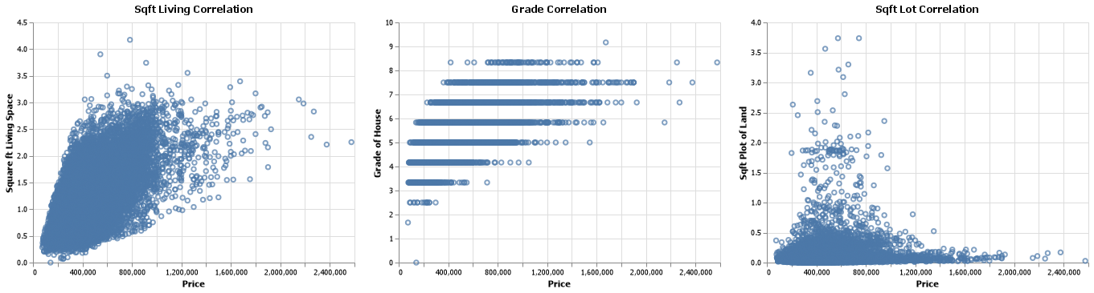
Resulting Data contamination = .15

Slide 13
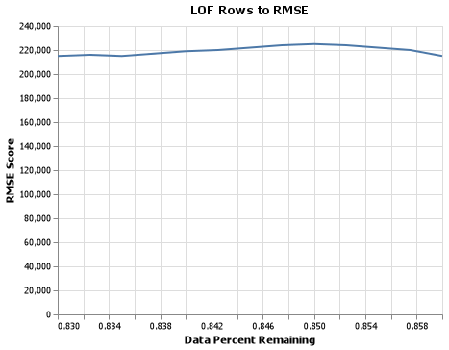
Local Outlier Factor See Appendix for more info

Slide 14
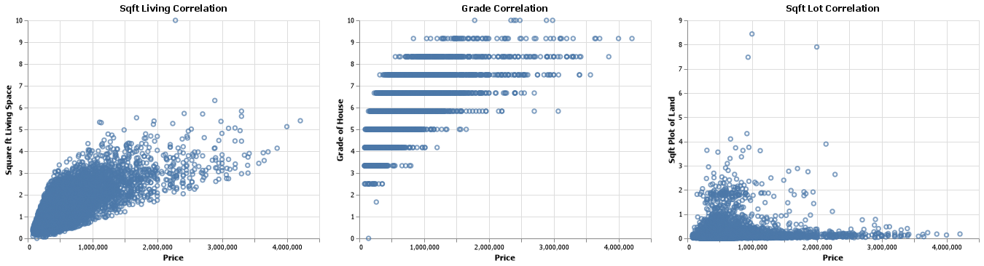
Resulting Data n_neighbors = 2 | metric = ‘Euclidean’

Slide 15
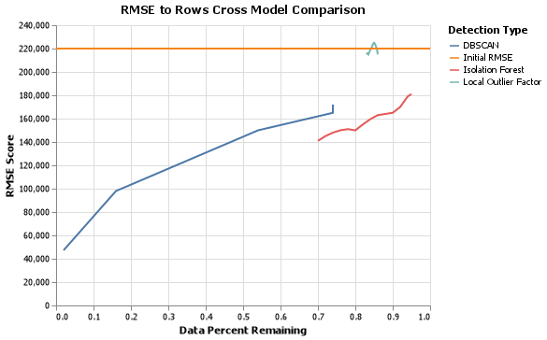
Cross Model Comparison

Slide 16
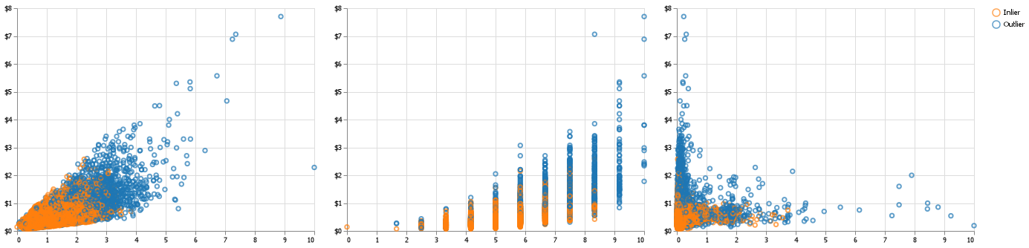

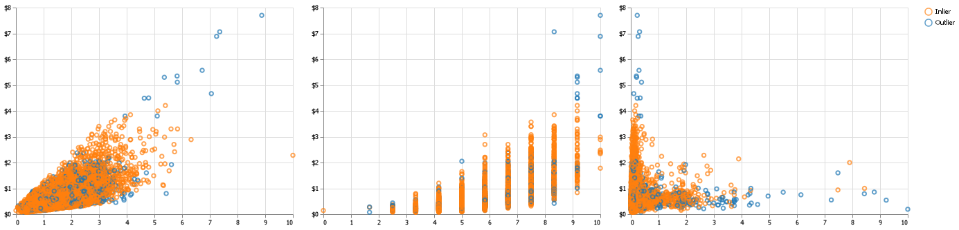
DBSCAN
Isolation Forest
Local Outlier Factor
PRICE
PRICE
PRICE
SQFT_LIVING GRADE SQFT_LOT

Slide 17
Thank you Q&A

Slide 18
Sources
Blondel, M. and Others (2007-2022). Machine Learning in Scikit-Learn. Scikit-Learn. Retrieved March 29, 2022, from https://scikit-learn.org/stable/index.html
King County Washington. (n.d.). Open data. King County Housing Data. Retrieved March 29, 2022, from https://data.kingcounty.gov/browse?category=Property%2B%26%2BAssessments

Slide 19
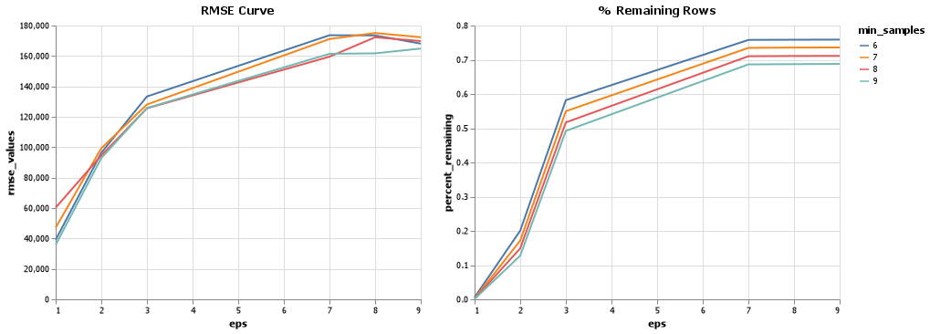
Appendix

Slide 20
